Slide 1
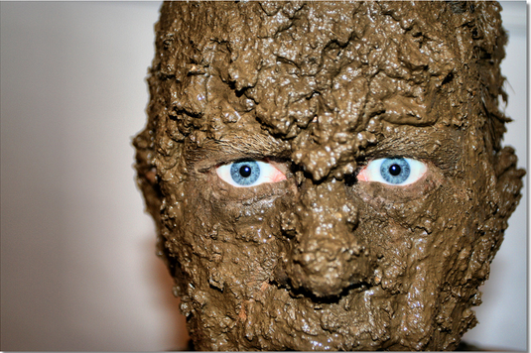
Project “Muddy” IST303 Group Project

Slide 2
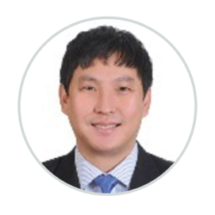
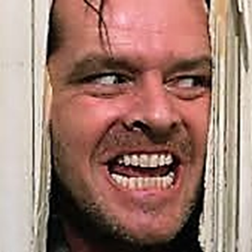
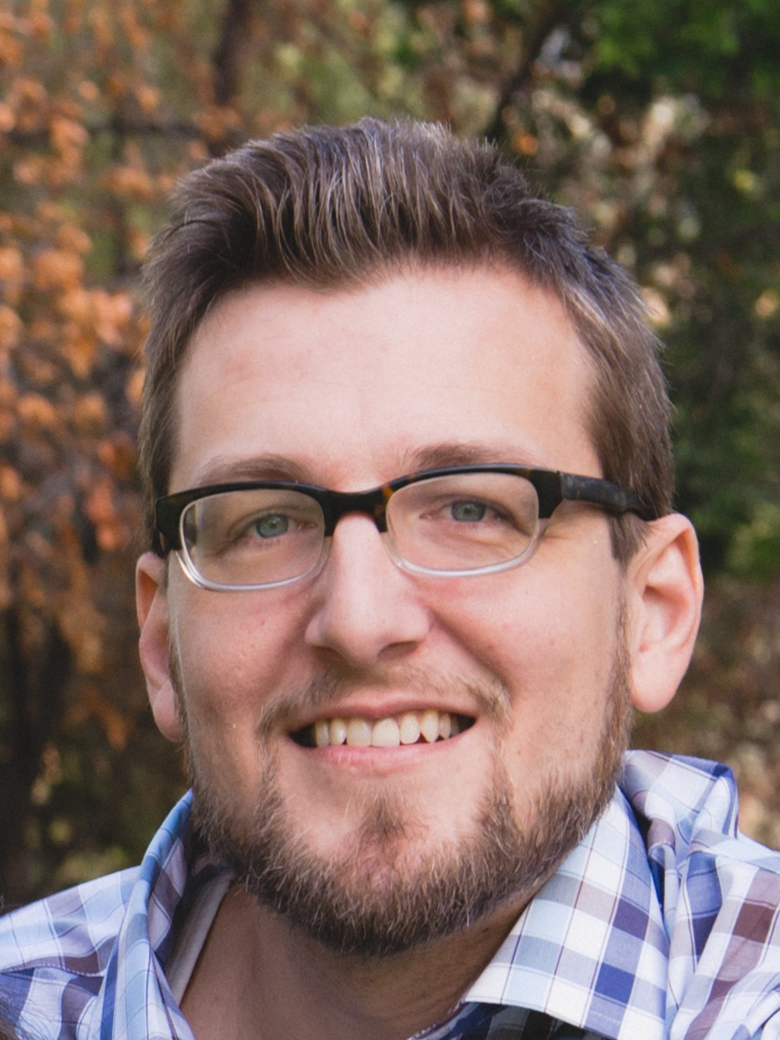
Our Software Development Team…
Ilya Mikhaltsou Project Leader Chief Programmer Ilya.Mikhaltsou@cgu.edu | Mark Kim Ambassador Business Analyst mark.kim@cgu.edu | David Kallemeyn Programing Team Leader Class Owner David.Kallemeyn@cgu.edu
Notes:
That used to be me.

Slide 3
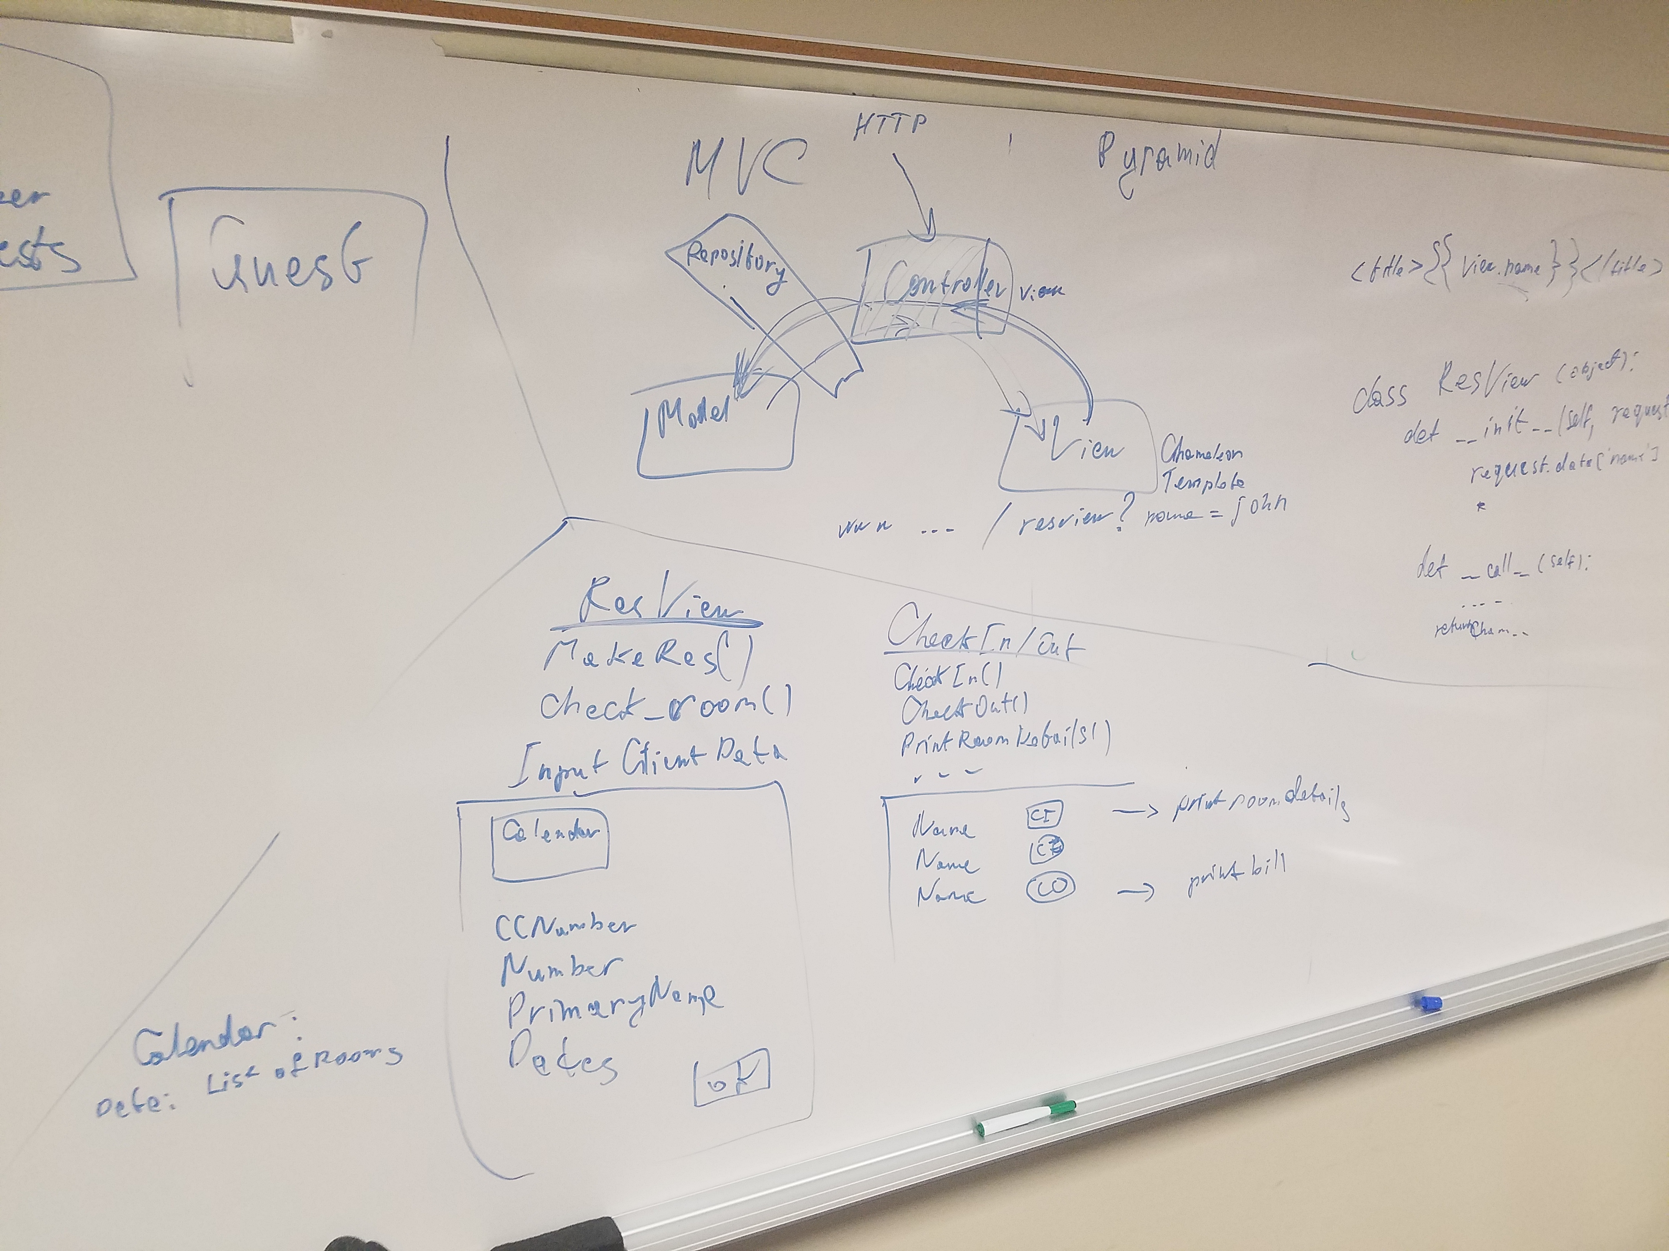
The AGILE process began with planning and brainstorming…
Evaluate Project Documents
Identify requirements
Analyze Assumptions
List of questions for Client
Role Assignments

Slide 4
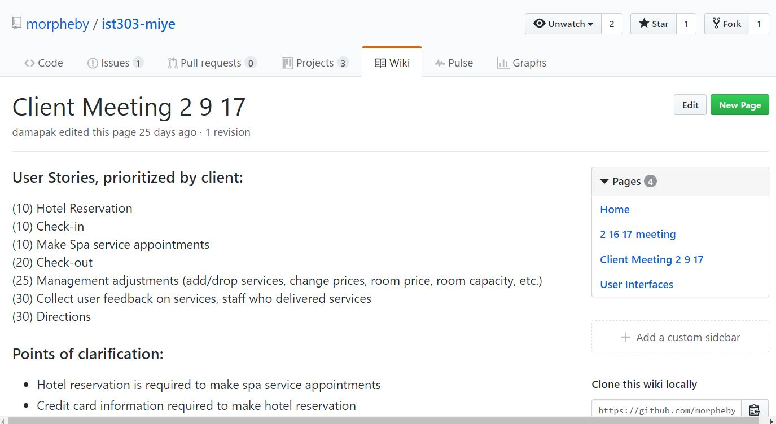
Client meetings framed our User Stories and gave insight into USER expectations and requirements…
Initial Client meeting:
User Stories
Client priorities
Test/clarify assumptions

Slide 5
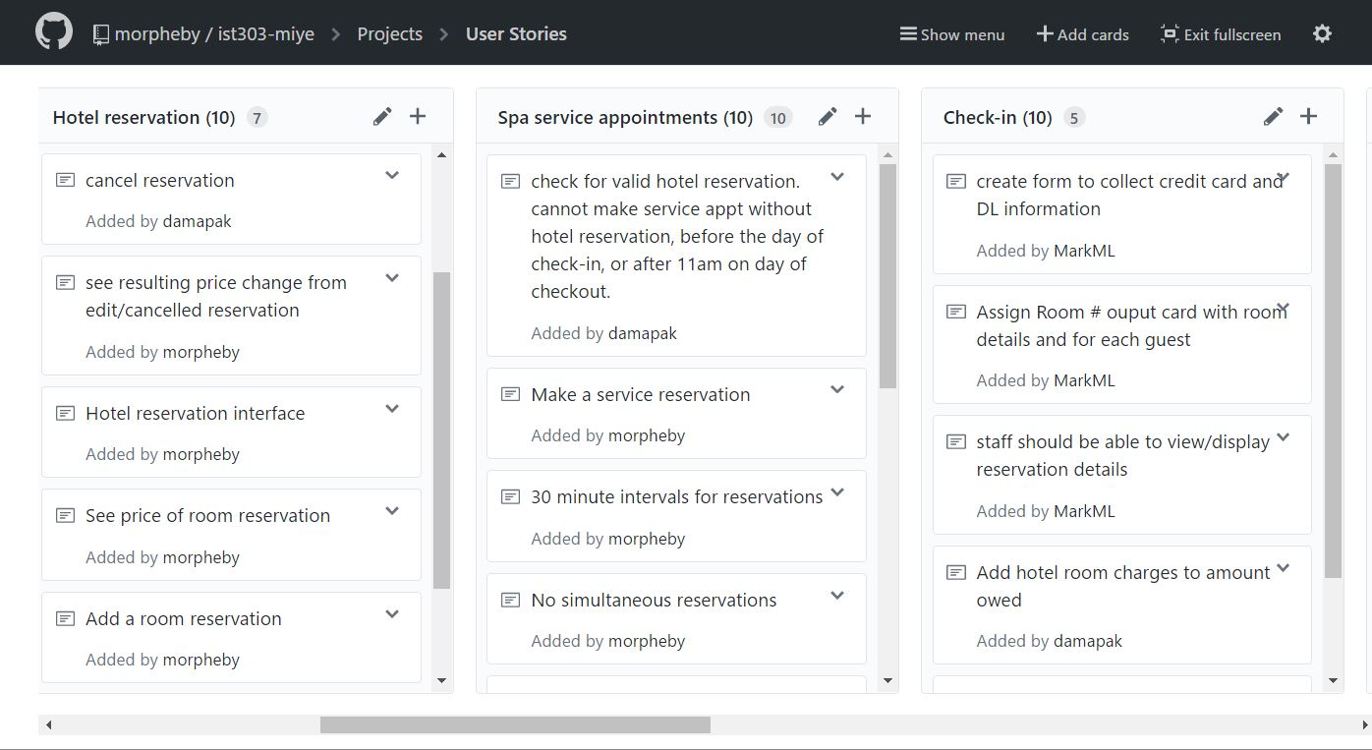
Once User Stories were solidified we created tasks and modified plans…
User Stories => Tasks
Estimate Iteration cycles
Timeline and Scheduling

Slide 6



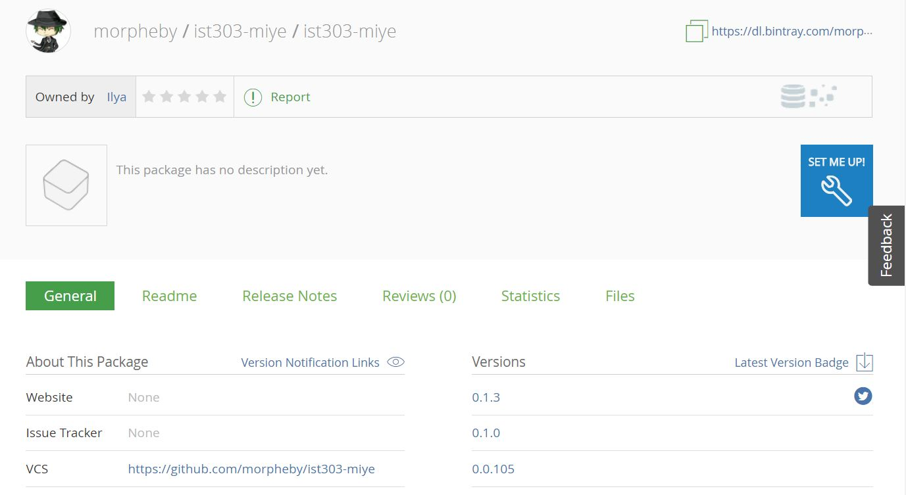

Collaborative Tools improved communication and efficiency within the team…
Identify software tools
Test software interoperability
Version Control workflow
Appveyor
Build/Test Windows
Github
Git push
Test results,
Build
Git push
Test results,
Build
Build/Test Linux/OS X
Artifact storage
Publish & distribute software
Manage distributions & access

Slide 7
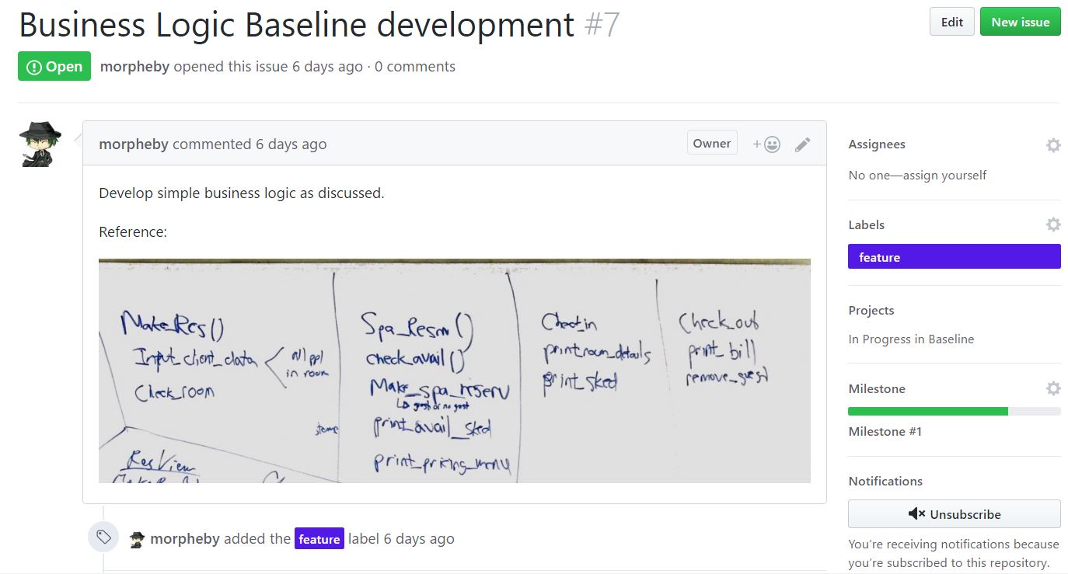
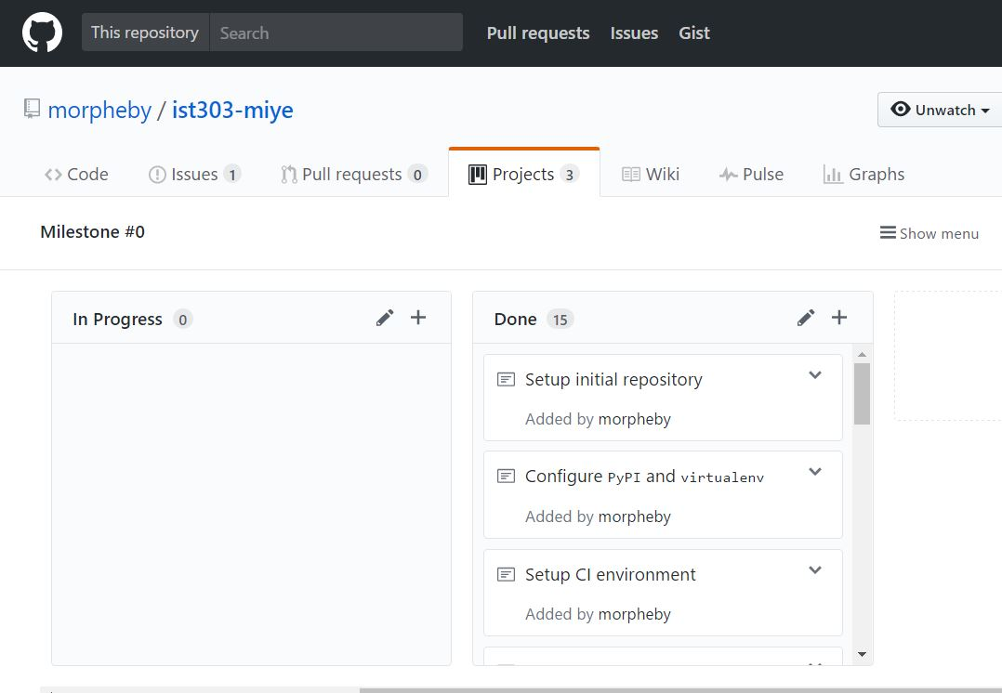
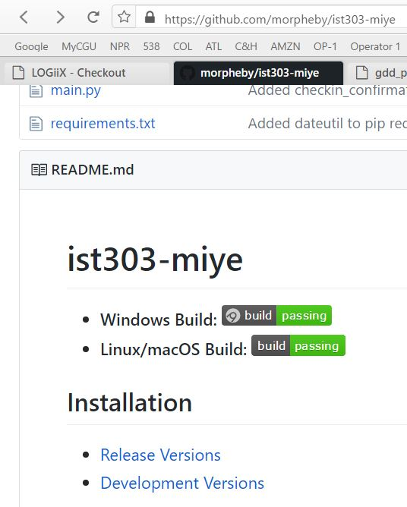
Github training montage:
UI tools:
Pyramid – python web framework
Chameleon – python HTML template engine

Slide 8
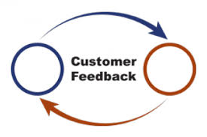
Even more client feedback guided us on track…
2nd round meetings with clients
Listen and ask more questions
Incorporate client changes
Are we on Track?

Slide 9
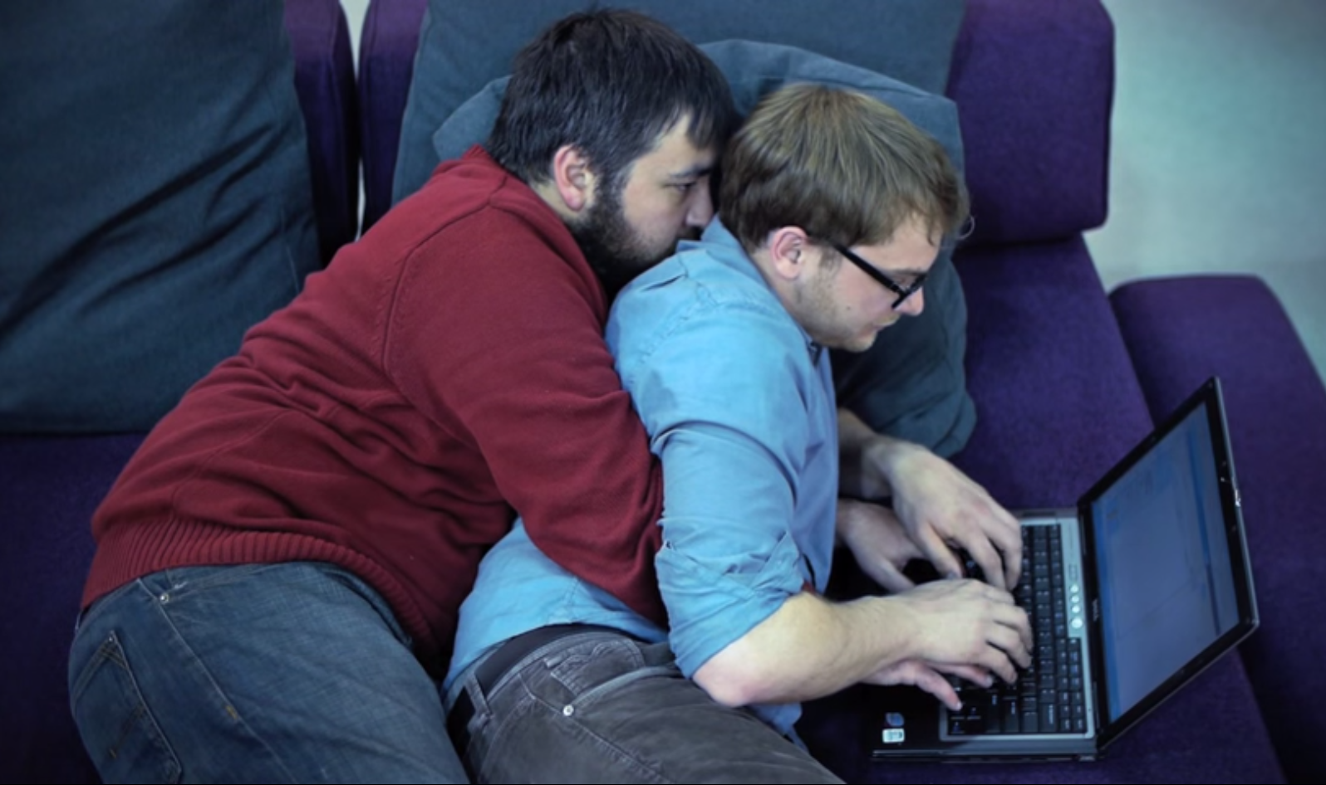
Coding in pair programming we iterated and improved working code…
2 person teams (rotating)
OOP – Python 3
Coding practices
Test and Improve

Slide 10
We met the client again seeking feedback in the prototype…
Demonstrate our Prototype
Client Feedback Incorporated
Back to Coding and Testing

Slide 11
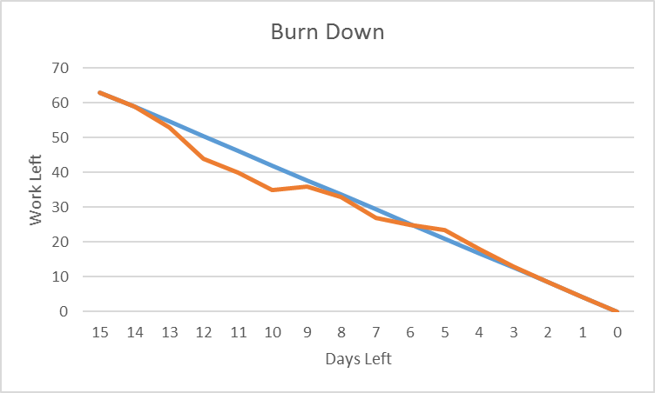
Build 1.0 on D-Day as on-time as planned…
Sprint to finish line
Deliver working code

Slide 12
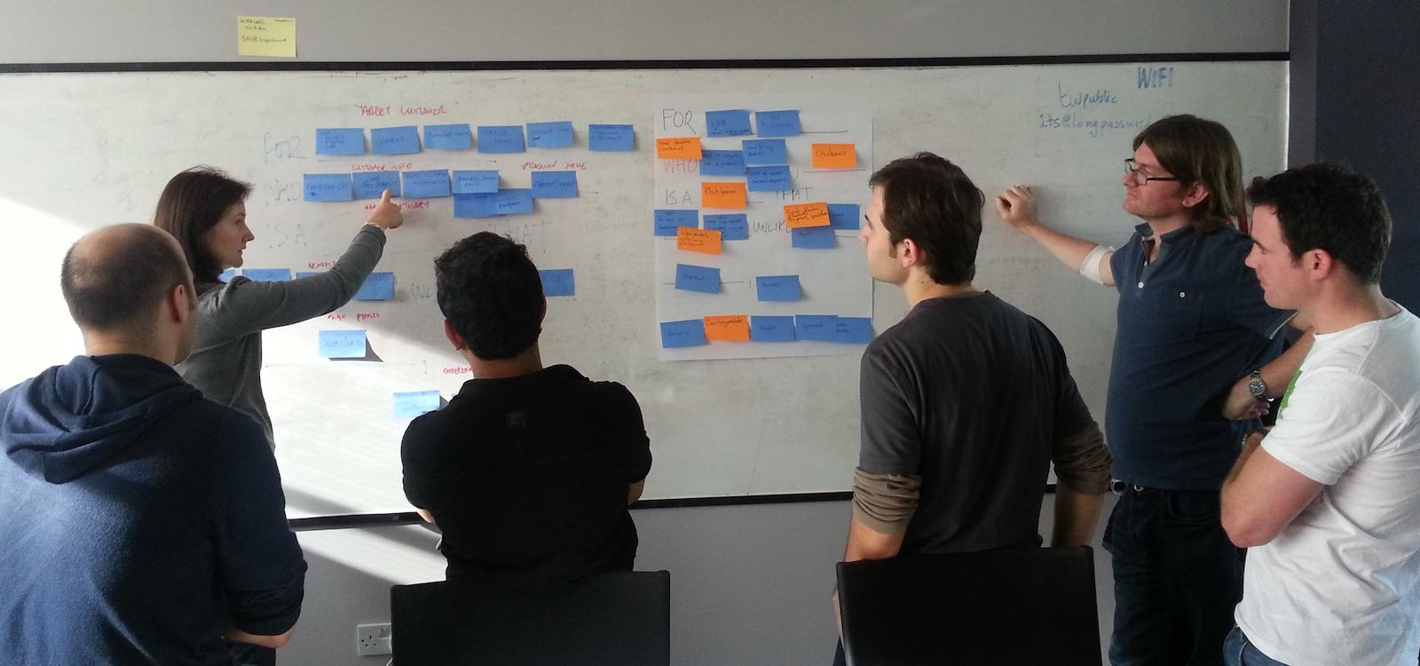
Planning continues towards project completion...
Spring Break as short rest
Refine Plans and Schedule
Additional client meetings
Keep Iterating

